Slide 1
Lecture 3
Data Categories, Visualizations, and Introductory Statistics

Slide 2
Announcements
Lab Party Times
Based on responses to surveys, lab parties will be held on these days this week.
Tomorrow, Tuesday August 2nd from 7pm to 9pm
Friday, August 5th from 4pm to 6pm
Lab 3 is released today after lecture.
Note on lab solutions: we will not be releasing solutions, but you can come to office hours or schedule an appointment to talk about them!
Final Project is being released soon as well, be on the lookout for the Google Classroom announcement.

Slide 3
Categories of Data

Slide 4
Quantitative
Data
Qualitative
Notes:
In general, there are 4 types of data grouped into two groups
Quantitative Data
Discrete
Counts
Continuous
Time
Qualitative Data
Nominal
Colors
Ordinal
Rankings

Slide 5
Discrete
Quantitative
Continuous
Data
Nominal
Qualitative
Ordinal
Notes:
In general, there are 4 types of data grouped into two groups
Quantitative Data
Discrete
Counts
Continuous
Time
Qualitative Data
Nominal
Colors
Ordinal
Rankings

Slide 6
Visualizations
Notes:
Much of data science is being able to visualize the types of data that you are working with in order to extract meaning and to be able to analyze it

Slide 7
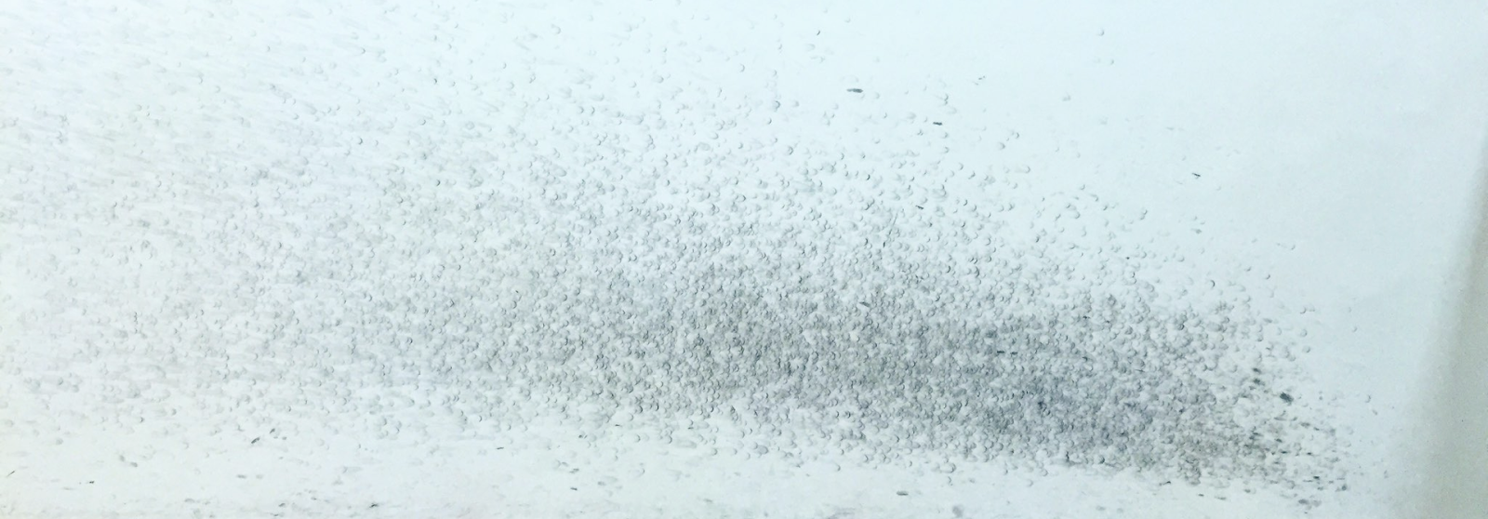
Notes:
Visualizations are not just bound to graphs that you see in papers, here are some data visualization that occur in our everyday lives!

Slide 8
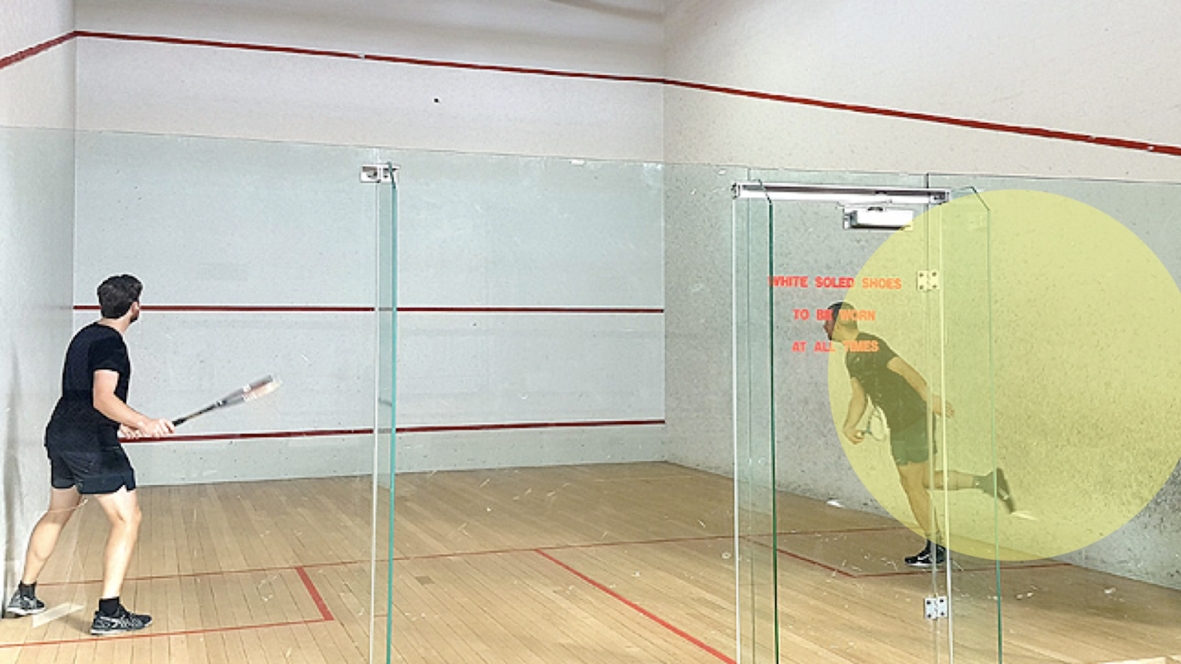
Squash ball bounce positions in a gym
Notes:
So we see what the visualization looks like, it’s a bunch of dots
What data might you be able to get from a game of squash, and what type might they be?

Slide 9


Slide 10
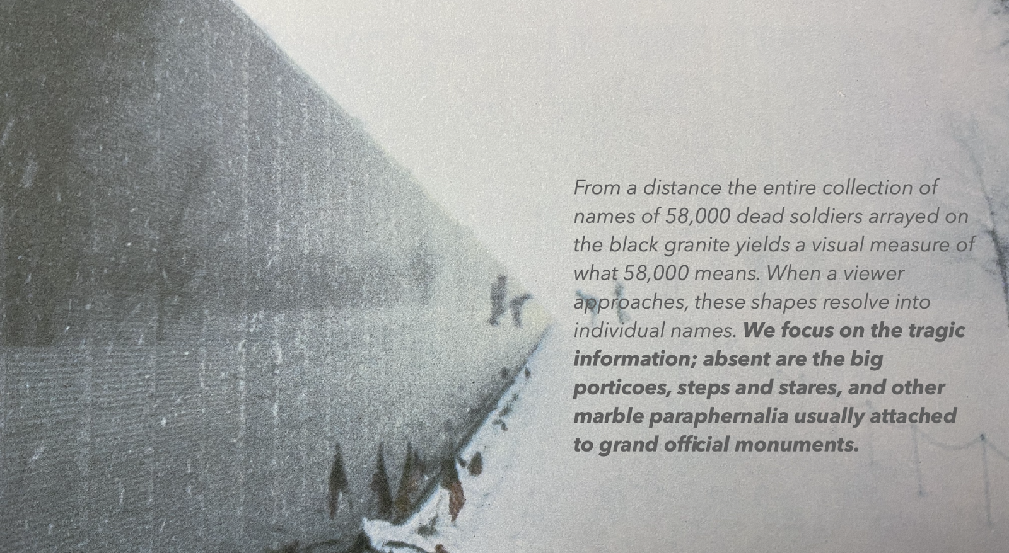
Soldiers who died in the Vietnam War (names ordered by their time of death)

Slide 11
Visualizations

Slide 12
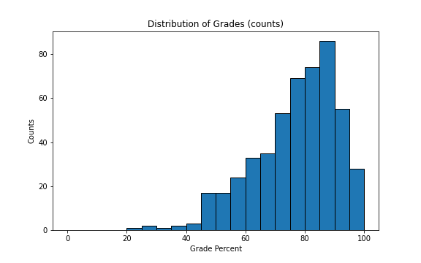
Histograms
One of the most commonly used graphs to visualize how a single quantitative variable is distributed
Different conventions of labelling the y-axis
Density
Counts

Slide 13
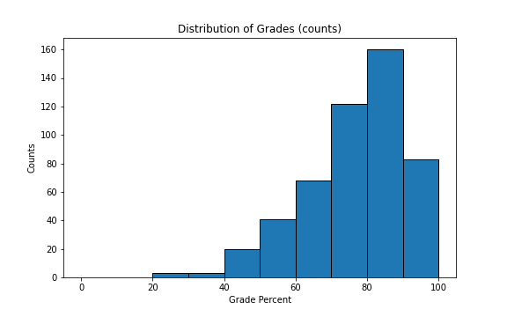
Histograms

Slide 14
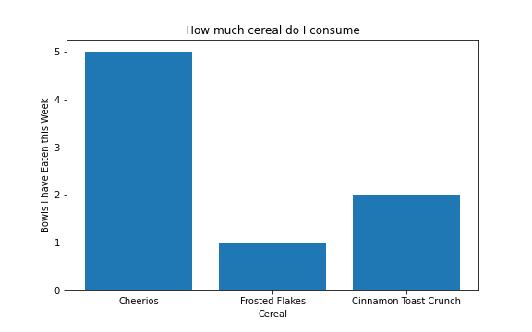
Histogram vs. Bar Chart
Quantitative Data - More interested in location
Qualitative Data - More interested in counts

Slide 15
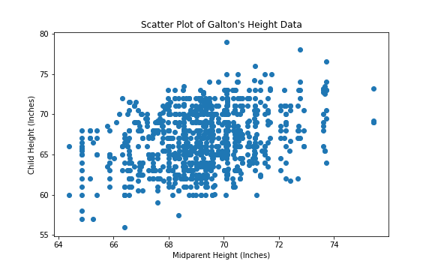
Scatterplots
One of the most commonly used graphs to visualize TWO quantitative variables, usually to understand how these two are related
Data must come in (x,y) pairs, where each point corresponds to one observation

Slide 16
Introductory Statistics

Slide 17
Measures of Center
Data: [1, 3, 6, 8, 9]
Average (or Mean) = (1 + 4 + 6 + 7) / 4 = 4.5
Not always going to be a number in the data
Somewhere between min and max, but not necessarily exactly halfway
Median = 6
Also not always going to be a number in the data
If even number of data, median will be the average between the two center values

Slide 18
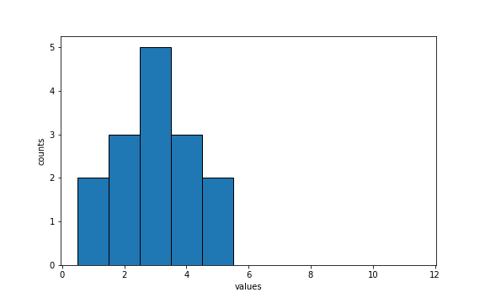
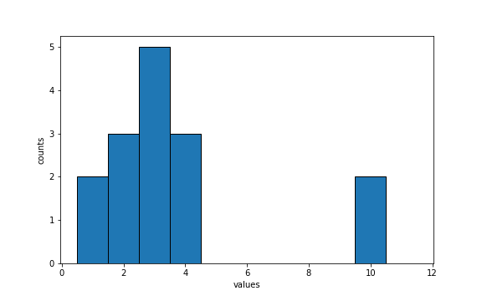
Discussion Question
Are the medians of these two distributions the same or different? Are the means same or different? If you say “different”, which one is bigger?
Notes:
Implement a zoom poll about this

Slide 19
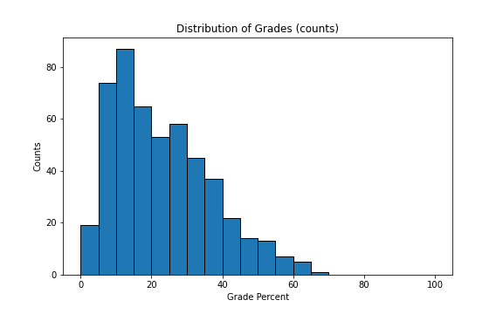
Skewness of Data
Left Skew - “Tail” on the left
Right Skew - “Tail” on the right

Slide 20

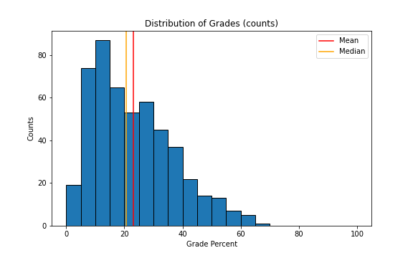
Skewness of Data
Left Skew - “Tail” on the left
Right Skew - “Tail” on the right

Slide 21
Comparing Mean and Median
Mean: “Balance” point of the data
Median: “Halfway” point of the data
Outliers will influence the mean and “skew” the mean down or up depending on the skewness of the distribution
The median will typically stay near the center - it is “robust” to outliers, as seen with our previous discussion
We call these “outliers”

Slide 22
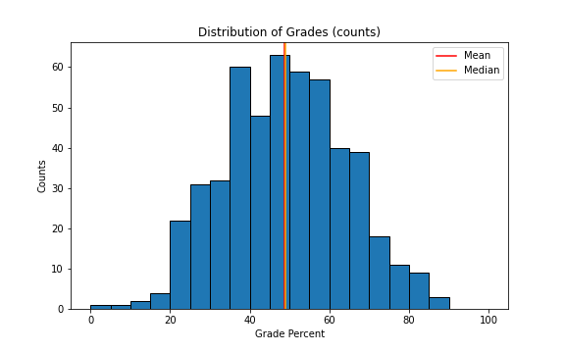
Symmetrically Distributed Data
No clear tail on either side of the distribution
Median and Mean will be roughly the same

Slide 23
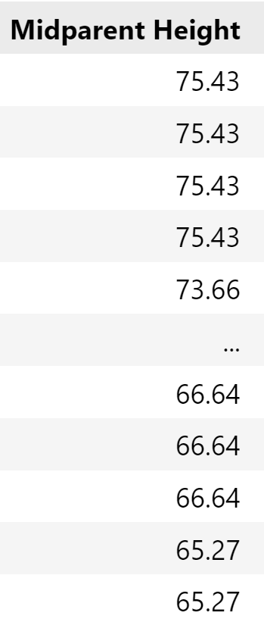
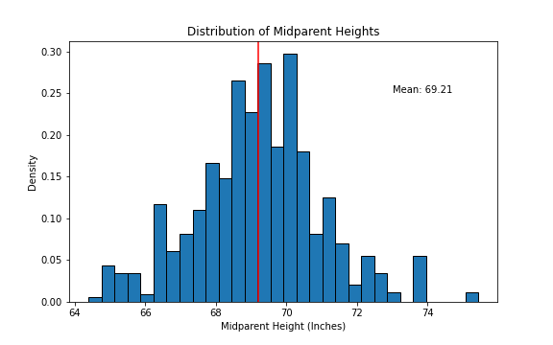
Galton’s Data - Calculating the Mean

Slide 24
Measure of Spread
Want to have some information about the variability of our data
Possible Methods?
Plan A: “biggest value - smallest value”
Problem - don’t know where the data is
Plan B: Measure how far the data is from the mean
Problem - need to figure out a way to quantify this

Slide 25
Variability from the Mean
The mean is a pretty good representation of the data - “average”
Let’s try to summarize how far everything is from the mean in one number
Standard Deviation (SD)
Measures on average how far away are we from the average.
Calculated as follows:
(5) Root (4) Mean (3) Squared (2) Deviation from the (1) Average
Also known as Root Mean Squared Error (RMSE)

Slide 26
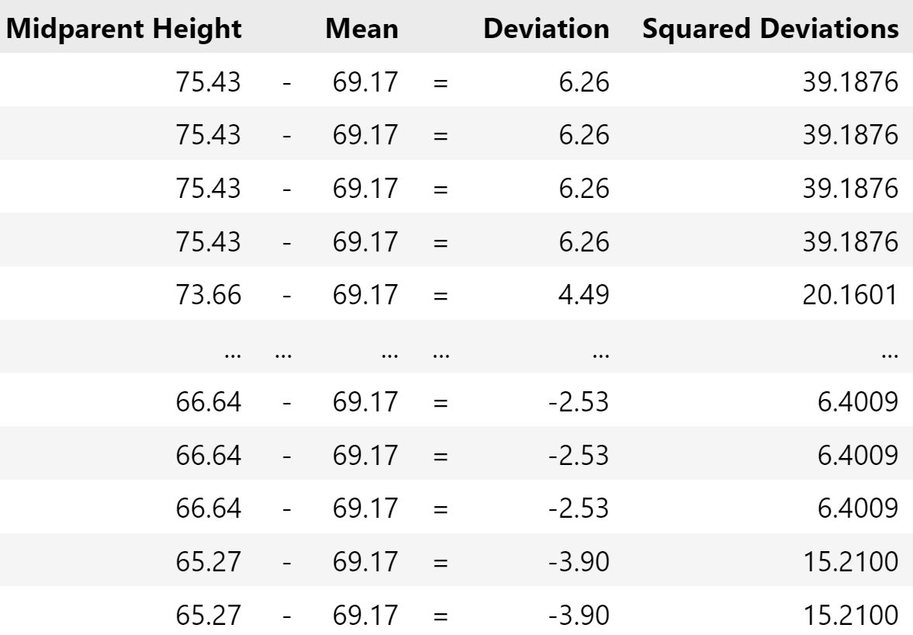
Galton’s Data - Calculating the SD
(5) Root (4) Mean (3) Squared (2) Deviation from the (1) Average
Average Midparent Height = 69.17 inches

Slide 27
Galton’s Data - Calculating the SD
(5) Root (4) Mean (3) Squared (2) Deviation from the (1) Average

Slide 28
Galton’s Data - Calculating the SD
(5) Root (4) Mean (3) Squared (2) Deviation from the (1) Average

Slide 29
Galton’s Data - Calculating the SD
(5) Root (4) Mean (3) Squared (2) Deviation from the (1) Average
Average ≅ 3.2464

Slide 30
Galton’s Data - Calculating the SD
(5) Root (4) Mean (3) Squared (2) Deviation from the (1) Average
√3.2464 ≅ 1.8018 inches

Slide 31
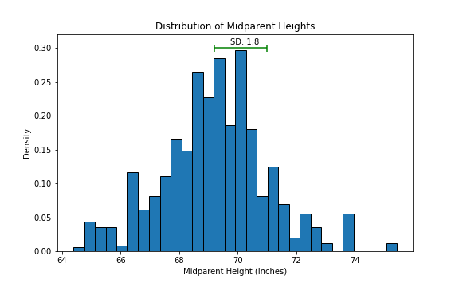
Galton’s Data - Calculating the SD
(5) Root (4) Mean (3) Squared (2) Deviation from the (1) Average

Slide 32
Standard Deviation is Useful!
Standard Deviation is expressed in the same units as the data
No matter what distribution, the majority of the data will always be within “a few standard deviations” away from the mean (Chebyshev’s Bounds)
Range | Proportion
average ± 2 SDs | at least 1 - 1/4 (75%)
average ± 3 SDs | at least 1 - 1/9 (88.888…%)
average ± 4 SDs | at least 1 - 1/16 (93.75%)
average ± 5 SDs | at least 1 - 1/25 (96%)

Slide 33
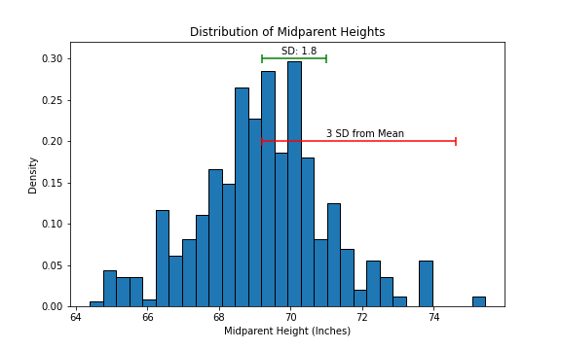
Standard Deviation is Useful!

Slide 34
Standard Units
Instead of describing data in its respective unit of measurement, we can use Standard Units (z):
z = (Value - Average)/SD
Very useful since this has no units associated with it!
Example

